Slide 1


Let’s choose our next restaurant!

Slide 2
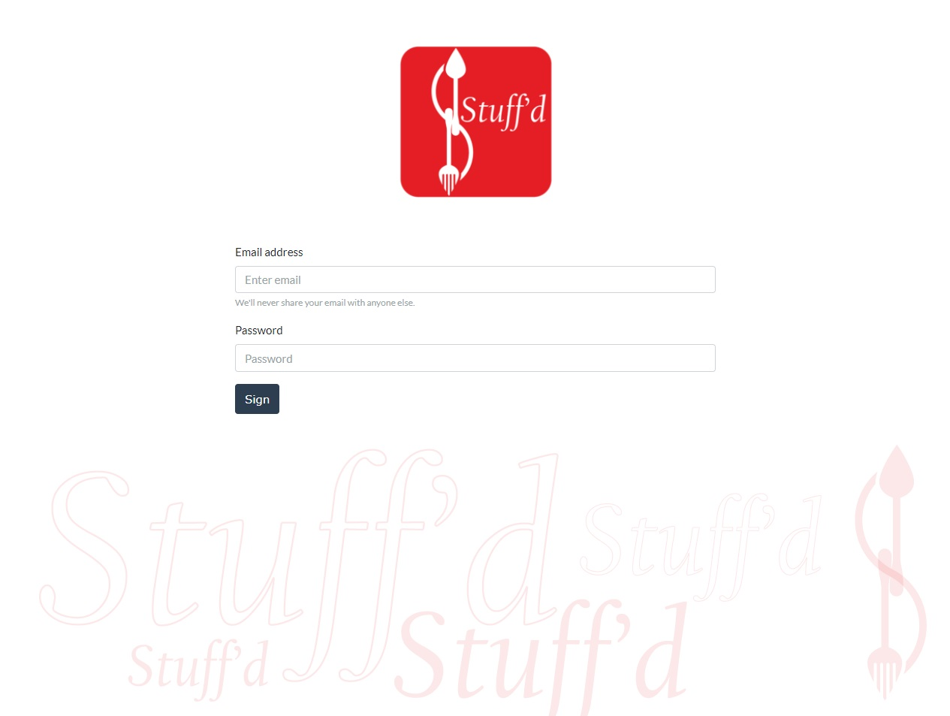
Sign Up
Page

Slide 3
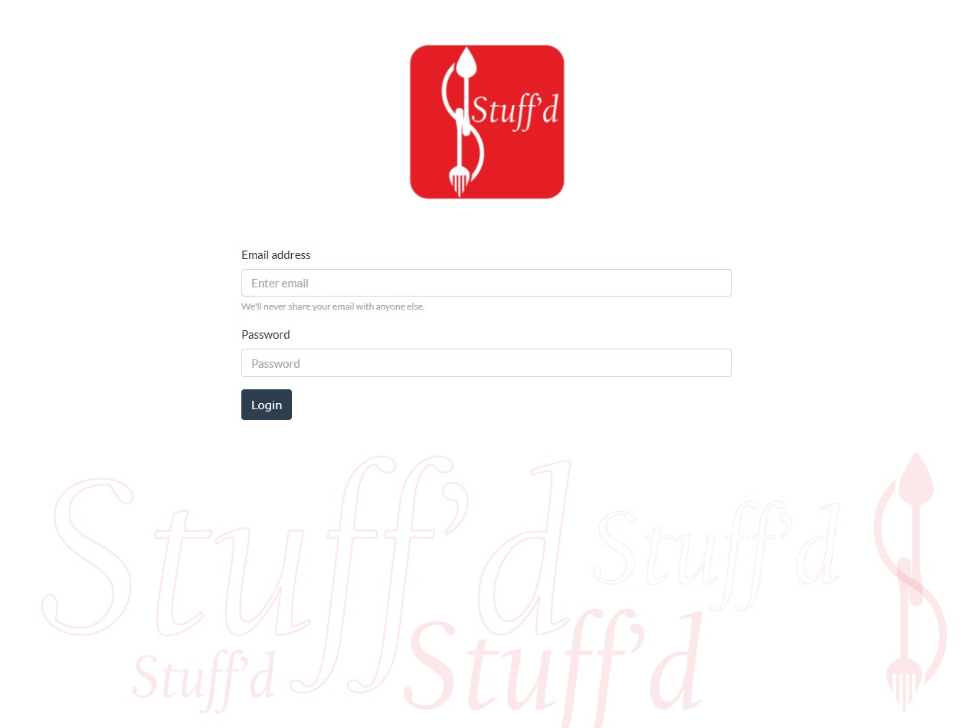
Login
Page

Slide 4
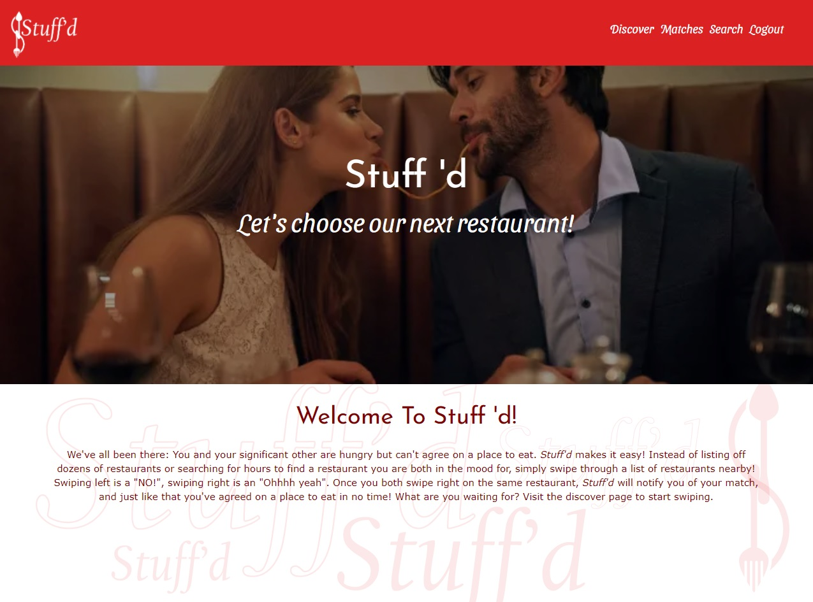

Home page

Slide 5
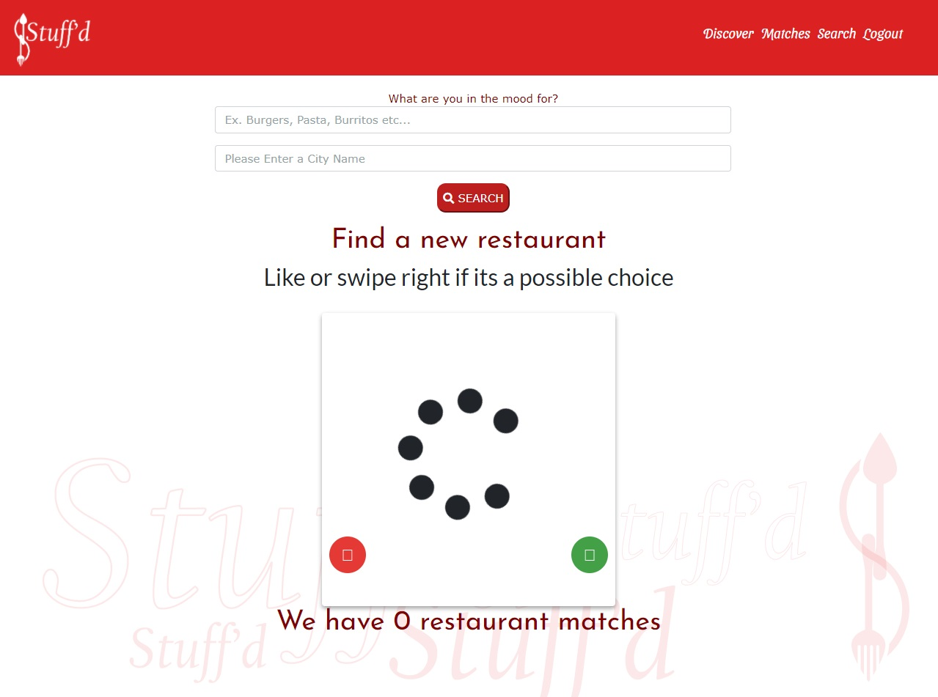
Discover
Page

Slide 6
Once you both swipe right on the same restaurant, Stuff'd will notify you of your match, and just like that you've agreed on a place to eat in no time!

Slide 7
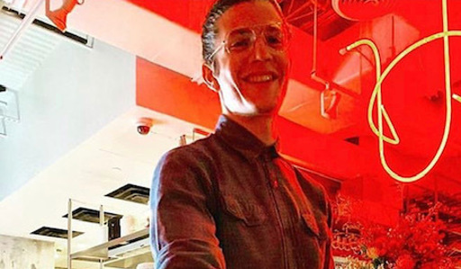
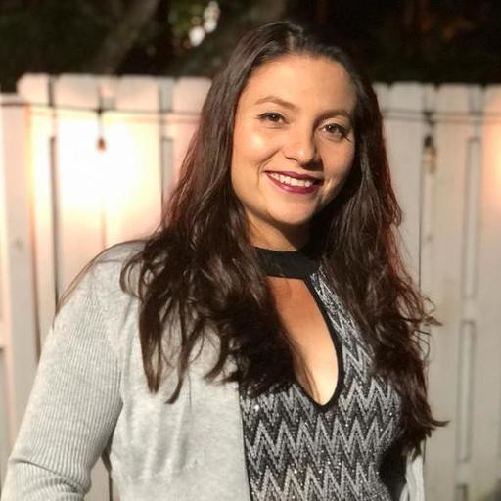
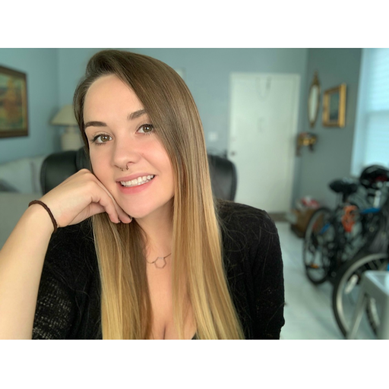
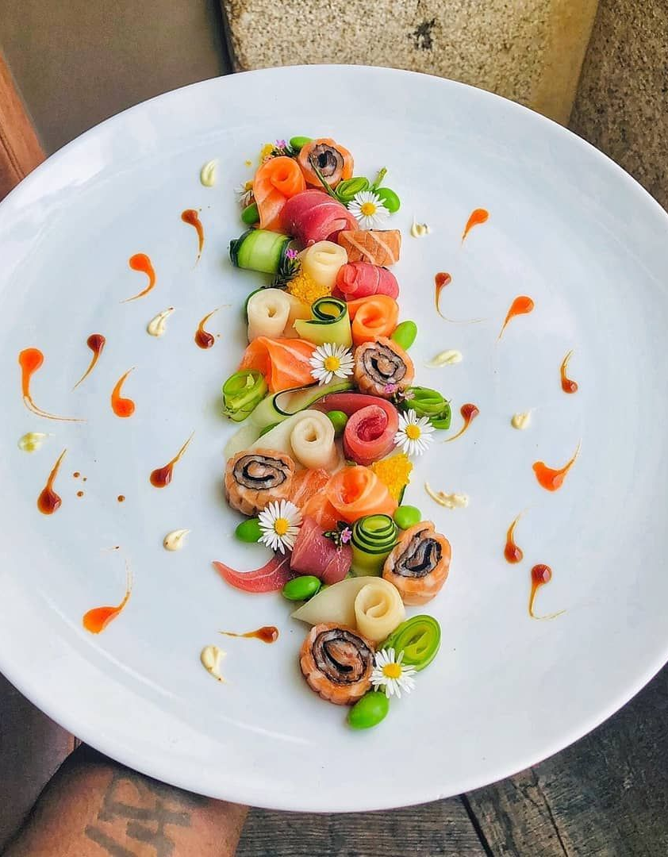
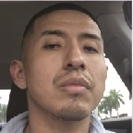
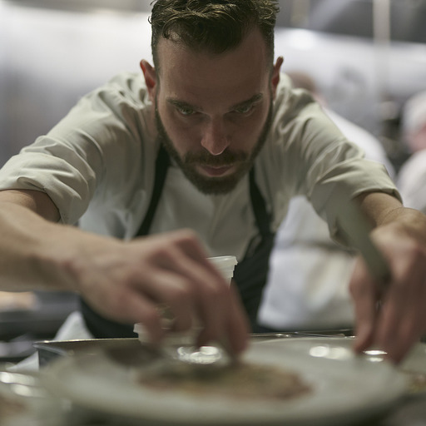
Team:
Alexander
Caitlin
Jeimmy
Marcos
Miguel

